Slide 1
Expertise

Slide 2
Outline
The Brain
Developing Expertise
How expertise changes things

Slide 3
The Brain
When we first learn something, it takes a good deal of the brain to do it.

Slide 4
The Brain
As we become experts, less brain activation is seen.
Therefore, we spend less mental energy on that task.

Slide 5
Developing Expertise
What does it take?

Slide 6
Developing Expertise
  Lot of hard work.
  At least 10 years of practice.

Slide 7
Developing Expertise
Deliberate Practice
  Required to become expert.
  Practice is highly motivated and carefully self monitored

Slide 8
Developing Expertise
Deliberate Practice
  Talent is not necessary, expertise is related to how much practice you get.
  Ex: Expert tennis players.

Slide 9
Developing Expertise
The brain and deliberate practice:
  Practice = grow more neurons
  Specifically in regions for expertise
    Skilled typists have more neurons in finger movement regions.

Slide 10
Developing Expertise
Skill acquisition - Gaining the skills that make us experts.
3 stages

Slide 11
Cognitive Stage
Develop a declarative encoding of the material.
Commit to memory the facts that are needed for the skill.

Slide 12
Cognitive Stage
Specifically what operations are necessary to perform skill.
  How to make the sound necessary for a tap step.

Slide 13
Cognitive Stage
Use of this knowledge is very slow, because the specific facts have to be retrieved.

Slide 14
Associative Stage
Errors are gradually reduced.
Connections between how to do steps are enhanced.
A successful procedure for the skill is created.

Slide 15
Autonomous Stage
Procedure becomes automatic.
Automatic = little attention and brain resources needed.

Slide 16
How Expertise Changes Things
Power Law
Procedularization
Tactical learning
Strategic Learning
Problem Solving
Transfer

Slide 17
Power Law
As we learn, performance improves exponentially.
For expertise – amount of attention/time/resources decreases exponentially.

Slide 18
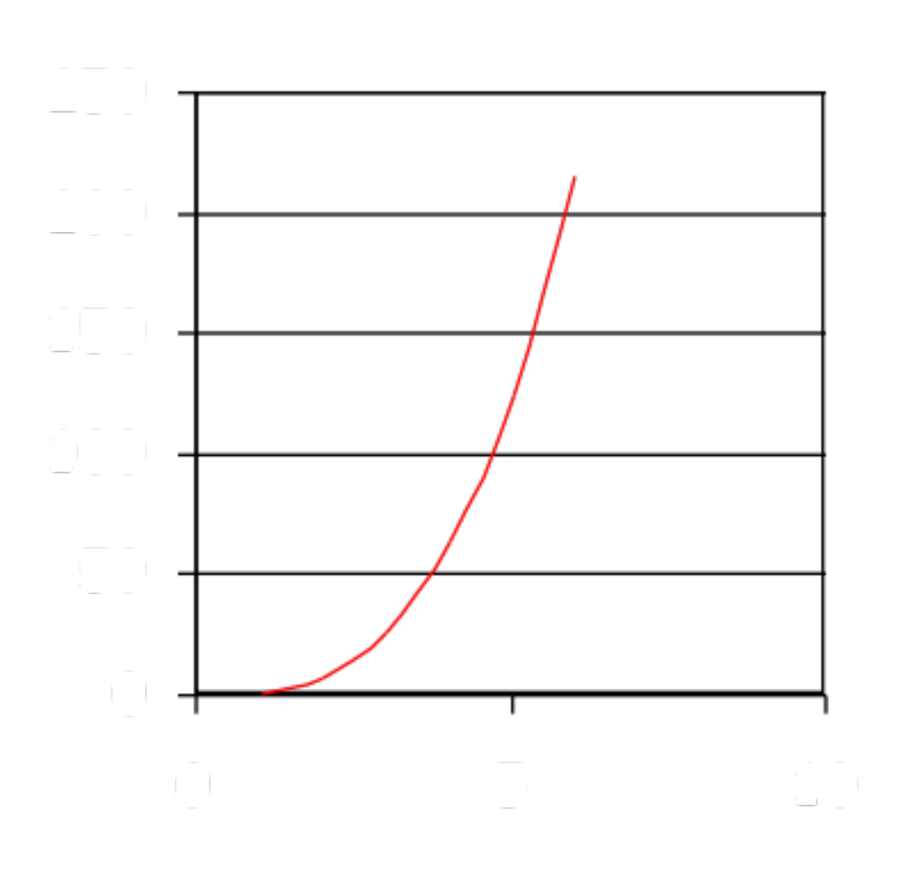
Power Law

Slide 19
Power Law
Given enough practice the time to do a task will approach zero
Only limits are machine, age, physical limits

Slide 20
Example
Koler’s Inverted Text Experiment
  Trained people on reading inverted text.
  IV: Inverted/Regular
  DV: How long they took to read

Slide 21
Example
Results:
  Inverted = 16 mins
  Regular = 1.6
Practice:
  Same rate

Slide 22
One Year Later…
Results:
  Inverted = 3.2 mins
  Regular = 1.6 mins
Retraining – took much less time and skill was regained quickly.

Slide 23
Proceduralization
Slowly people move from declarative to procedural knowledge
No longer require verbal recall of rules.
Start to recognize patterns to apply rules to.

Slide 24
Tactical Learning
Learning to execute a sequence of actions.
Tactic – method that accomplishes a particular goal.

Slide 25
Brain Tactics
As you switch from solving to retrieving:
  Prefrontal > posterior > hippocampus.

Slide 26
Strategic Learning
Learning of how to organize one’s problem solving for a specific class of problems.
Why? Rules change.

Slide 27
Strategic Learning
Novices work in a bottom up method
  What do I need? How do I get that?
Experts work in a top down manner
  What do I have to get me to the goal?

Slide 28
Problem Solving
As we become experts, develop a large set of perceptual features for encoding problems.

Slide 29
Problem Solving
For example, when you ask people to classify objects
  Novices use surface features
  Experts use semantic principles

Slide 30
Transfer of Skill
Expertise is very narrow.
Often a failure to transfer skills to similar domains and no transfer to different domains.

Slide 31
Transfer of Skill
Street Vendors
  IV: Street problems/Math Problems
  DV: Percent correct
Results
  Don’t transfer to math problems.

Slide 32
Transfer of Skill
Identical elements -transfer of one skill to another only to the extent that the skill have same knowledge elements in common.

Slide 33
Transfer of Skill
Positive Transfer – must have the same situation – response, therefore same rules, facts, patterns

Slide 34
Transfer of Skill
Negative transfer – learning one skill will make a person worse at learning another skill
  Partially due to interference.

